Slide 1
Lecture 4
Self-exploration as the Process for
Value Education

Slide 2
Content of this Session इस सत्र कि विषय-वास्तु
About this workshop/course
Process of self-exploration
(in more detail)
We will also explore:
  Do we have the potential to recognize what is right?
  Can we be self-referential?
इस शिविर/course के बारे
अध्ययन प्रक्रिया
(विस्तार)
हम लोग यह भी जांचेंगे कि:
  क्या हम में सही को पहचान पाने की क्षमता है?
  क्या हम स्वतंत्र हो सकते हैं?

Slide 3
What is this Workshop / Course ;g f'kfOkj D;k gS
It is a process of dialogue – between me and you, to begin with
;g laokn dh izfØ;k gSA ;g laokn vkids vkSj esjs chp 'kq: gksrk gSA
2. It soon becomes a dialogue within your own Self…
“kh?kz gh ;g laokn vkids Lo;a eas pyus yxrk gSA

Slide 4
The Dialogue Within
1. We have to discover our natural acceptance
(where we want to reach)
What I Really Want to Be
My Natural Acceptance
My Intention
Always
Relationship
3. We have to ensure this dialog and ensure harmony within
(evaluate our desires vis-à-vis our natural acceptance)
These are in Contradiction
Unhappiness
These are in Harmony
Happiness
Dialogue
What I am
My Desire, Thought, Expectation…
My Competence
Sometimes
Opposition
Sometimes
Relationship
2. We have to find out what I am
(where we are now)

Slide 5
Points for Self-observation
We have the innate potential to recognise what is right
We are endowed with natural acceptance
It is innate, a part and parcel of our being
It is invariant, uncorrupted by pre-conditioning
It is definite
As we refer to our natural acceptance, we become self-referential
(self-organised, autonomous, swatantra)

Slide 6
Process of Self-exploration, Self-investigation
It is a process of dialogue – between me and you, to begin with. It soon becomes a dialogue within your own self
It is a process of dialogue between what I am (tSlk eSa g¡w) and my Natural Acceptance or what I really want to be (tSlk gksuk eq>s lgt Lohdk;Z gS = LoRo)
It is a process of Self-exploration, Self-investigation → Self-evolution
It is a process of knowing oneself and through the self, knowing Nature and the entire existence
It is a process of recognizing one's relationship with every unit in nature/existence; and fulfilling that relationship
It is a process of knowing Human Conduct (ekuoh; vkpj.k) and living according to it
It is a process of living in harmony within, living in harmony with others…living in harmony with entire existence

Slide 7
v/;;u izfdz;k
1- ;g ,d Lkaokn dh izfdz;k gSA
2- ;g Lo;a ¼tSlk eSa gw¡½ dh vius LoRo ¼tSlk gksuk eq>s lgt Lohdk;Z gS½ ls laokn dh izfdz;k gSA
3- ;g Lo;a esa] Lo;a ds vf/kdkj ij tk¡pus dh izfdz;k gSA
4- ;g Lo;a dks ,oa Lo;a ds ek/;e ls laiw.kZ vfLrRo dks le>us dh izfdz;k gSA
5- ;g vfLRkRo dh gj bdkbZ ds lkFk vius laca/k dks igpkuus ,oa rnuqlkj thus dh izfdz;k gSA
6- ;g ekuoh; vkpj.k dks le>us ,oa rnuqlkj thus dh izfdz;k gSA
7- ;g Lo;a esa Lora=rk ,oa lexz vfLrRo ds lkFk LojkT;iwoZd thus dh izfdz;k gSA
LoRo Lrra=rk LojkT;

Slide 8
Scope of this Workshop / Course: Self-evolution, Self-extension
Knowing your Natural Acceptance
What you really want to be
Natural Acceptance Swatva LoRo
Living in accordance with your Natural Acceptance
Living in harmony within
Self-organized Swatantrata Lora=rk
Living in harmony with others… with the entire existence
Self-extension Swrajya LojkT;
Harmony Everywhere = Universal Order

Slide 9
शिविर का आशय
viuh lgt Lohd`fr dks ns[kuk@le>uk
tSlk gksuk eq>s lgt Lohdk;Z gS
LoRo
lgt Lohd`fr ds vk/kkj ij Hkko] fopkj
Lo;a esa O;oLFkkiwoZd thuk
Lora=rk
nwljksa ds lkFk laca/k@O;oLFkkiwoZd thuk & laiw.kZ vfLrRo ds lkFk
LojkT;

Slide 10
Conscience, Science & Sense of Living
Conscience – Meaning (sarthakta)
Purpose, Goal, Innate, Basic Desire
What to Do as a Human
Relationship: Contemplation of Participation (swabhav, sambandh)
Vyavastha: Understanding of Self-organisation (vyavastha),
Co-existence: Realisation of Coexistence (sah-astitva)
Science – Thought, Feeling of Coexistence, How to Do
Sense – Behaviour, Work, Participation in Human Order with the thought & feeling of Coexistence

Slide 11
Self-exploration, Self-investigation
1. Content of Self Exploration:
  a. Desire (pkguk) - Aim, Objective, Purpose, Basic Human Aspiration
What do I want to achieve?
  b. Program (djuk) – Process of achieving the desire, action
How do I achieve it ?
2. Process of Self Exploration

Slide 12
Content of Self-exploration a) Desire
Happiness
Prosperity
The continuity of Happiness and Prosperity
Let us find out:
  Do we desire for Happiness?
  Do we desire for Prosperity?
  Do we desire for the continuity of both (happiness & prosperity)?
  If continuity of happiness and prosperity is ensured then what else would you desire?
  Our desires are not unlimited or indefinite
  Our basic aspiration is for happiness, prosperity and its continuity

Slide 13
Self-exploration, Self-investigation
1. Content of Self Exploration:
  a. Desire (pkguk) - Aim, Objective, Purpose
What do I want to achieve?
  b. Program (djuk) – Process of achieving the desire, action
How do I achieve it ?
2. Process of Self Exploration
a. Whatever is stated is a Proposal
Do not assume it to be true/ false
Verify it on your own right
b. Self-verification
Happiness, Prosperity
Continuity

Slide 14
Process of Self-verification
Whatever is stated is a Proposal (Do not assume it to be true/ false)
Verify it on your own right
Proposal
1
2
Verify
on the basis
Of
your
Natural
Acceptance
Experiential Validation
Live according to it
2a
2b
Behaviour with
Human Beings
Work with
Rest of Nature
Mutual Happiness
Mutual Prosperity
Which process is Naturally Acceptable to you?
A process of self-exploration, self-verification on your own right, leading to understanding in yourself
or
A process of do’s & don’ts, in which you assume what is said, without verification
RIGHT
UNDERSTANDING

Slide 15
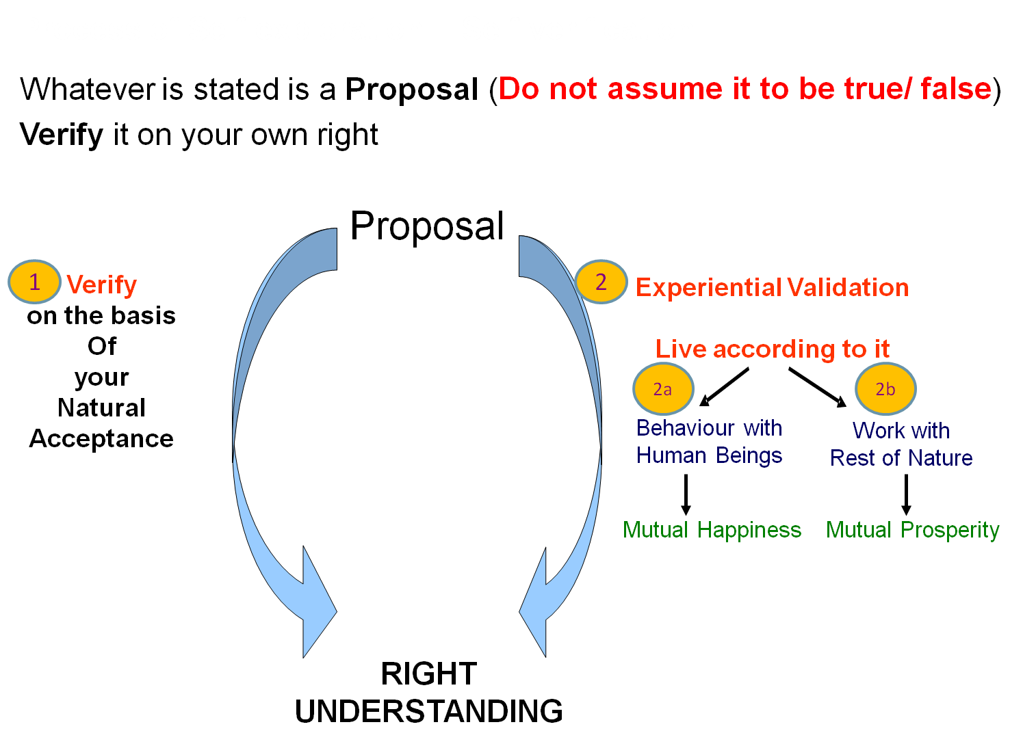
Sum Up
Content of self-exploration = Basic human desire
= Happiness, prosperity → continuity
Process of self-exploration
= Self-investigation, self-verification
It is a process of
living in harmony within,
living in harmony with others…
and ultimately,
living in harmony with the entire existence
The Purpose of this workshop/course is to initiate self-exploration in you

Slide 16
Self Reflection

Slide 17
Self-reflection
Who would decide what is valuable for you? Yourself or someone else?
Do you want to be able to decide on your own right or
Do you want to assume what is told by somebody, to be dependent on it to decide for you?
Are you able to see your desires, your thoughts, i.e. what you are?
Are you able to see your natural acceptance?
Are you able to see if there is a dialogue between what you are and your natural acceptance?
Are you able to see that when what you are is in harmony with your natural acceptance, you are in a state of happiness? And when what you are is in contradiction with your natural acceptance, you are in a state of unhappiness

Slide 18
FAQ

Slide 19
FAQ
We have to follow social norms and live as per family traditions to be accepted in the society, or even in the family. This has been working for a long time. Do we need to verify these norms and traditions also?
What is the source of the proposals? If the source is verified, is authentic, then we can accept the proposals – and do we don’t need to verify them again. Right?
What we accept is something quite subjective, different things appeal to different people – How can we say that natural acceptance is same for everybody? Actually what is this natural acceptance?
How is it possible to understand everything by through the self? Just being aware of “what I am” and “what I really want to be” itself is so difficult.
Isn’t swatantrata and freedom the same? (please give examples of swatantrata at each level of being – individual, family, society and nature)

Slide 20
Self-Discipline, Self-Confidence Lovuq'kklu] vkRefo”okl
Assuming ekuuk
Knowing
tkuuk
Imitate vuqlj.k (0-3)
Family
ifjokj
School
fo|ky;
University
fo”o&fo|ky;
Society
lekt
Follow vuqdj.k (3-6)
Obedience/Discipline
vkKkikyu@vuq'kklu (5-9)
Relationship
laca/k
Right
lgh
Self-verif
Tkk¡p
The child is swatantra…
Knowing, not just assuming
Is following internally guided discipline (right understanding) …
which is fulfilling for the child & for others
Self Discipline (10…)
Lo&vuq'kklu
Self-confidence
vkRefo”okl

Slide 21
Self-Discipline, Self-Confidence Lovuq'kklu] vkRefo”okl
Assuming ekuuk
Knowing
tkuuk
Imitate vuqlj.k (0-3)
Family
ifjokj
School
fo|ky;
University
fo”o&fo|ky;
Society
lekt
Follow vuqdj.k (3-6)
Next Generation
Obedience/Discipline
vkKkikyu@vuq'kklu (5-9)
Relationship
laca/k
Right
lgh
Self-verif
Tkk¡p
Self Discipline (10…)
Lo&vuq'kklu
Self-confidence
vkRefo”okl
Every next generation is more developed
In harmony within
In harmony with family
In harmony with society
In harmony with nature/existence

Slide 22
Self-Discipline, Self-Confidence Lovuq'kklu] vkRefo”okl
Assuming ekuuk
Imitate vuqlj.k (0-3)
Family
ifjokj
School
fo|ky;
University
fo”o&fo|ky;
Society
lekt
Follow vuqdj.k (3-6)
Obedience/Discipline
vkKkikyu@vuq'kklu (5-9)
Domination
'kklu
Self-verif
Tkk¡p
Wrong
xyr
Arbitrariness euekuh

Slide 23
Self-Discipline, Self-Confidence Lovuq'kklu] vkRefo”okl
Assuming ekuuk
Imitate vuqlj.k (0-3)
Family
ifjokj
School
fo|ky;
University
fo”o&fo|ky;
Society
lekt
Follow vuqdj.k (3-6)
Obedience/Discipline
vkKkikyu@vuq'kklu (5-9)
Domination
'kklu
Self-verif
Tkk¡p
Wrong
xyr
Arbitrariness euekuh
The child is partantra…
Is still assuming, not knowing
Is still going by externally enforced discipline (fear/ incentive)… which may not be fulfilling for the child nor for others
Opposition nz®g (8-12)
Revolt fonz®g (by other)
Struggle laÄ‘kZ (13-30)
War ;q) (30…)

Slide 24
Self-Discipline, Self-Confidence Lovuq'kklu] vkRefo”okl
Assuming ekuuk
Imitate vuqlj.k (0-3)
Family
ifjokj
School
fo|ky;
University
fo”o&fo|ky;
Society
lekt
Follow vuqdj.k (3-6)
Next Generation
Obedience/Discipline
vkKkikyu@vuq'kklu (5-9)
Domination
'kklu
Self-verif
Tkk¡p
Wrong
xyr
Arbitrariness euekuh
Every next generation is less developed
In more contradiction within
In more opposition with family
More struggle in society
More conflict with nature/ existence
Opposition nz®g (8-12)
Revolt fonz®g (by other)
Struggle laÄ‘kZ (13-30)
War ;q) (30…)

Slide 25
Self-Discipline, Self-Confidence Lovuq'kklu] vkRefo”okl
Assuming ekuuk
Knowing
tkuuk
Imitate vuqlj.k (0-3)
Human
Education-sanskar
ekuoh;
f”k{kk-laLdkj
Family
ifjokj
School
fo|ky;
University
fo”o&fo|ky;
Society
lekt
Follow vuqdj.k (3-6)
Next Generation
Obedience/Discipline
vkKkikyu@vuq'kklu (5-9)
Relationship
laca/k
Right
lgh
Domination
'kklu
Self-verif
Tkk¡p
Wrong
xyr
Arbitrariness euekuh
Self Discipline (10…)
Lovuq'kklu
Self-confidence
vkRefo”okl
Opposition nz®g (8-12)
Revolt fonz®g (by other)
Struggle laÄ‘kZ (13-30)
War ;q) (30…)

